Slide 1
Characteristics of Measurement Instruments
By
Candida Nakida Mwisomba

Slide 2
Performance characteristics
Static characteristics
The set of criteria defined for the instrument, which are used to measure quantities which are slowly varying with time or mostly constant i.e. do not vary with time is called static characteristics.
Dynamic characteristics
When the quantity under measurement change rapidly with time, it is necessary to study the dynamic relations existing between input and output which is expressed as differential equation.
The set of criteria defined based on such dynamic differential equation is called dynamic characteristics.

Slide 3
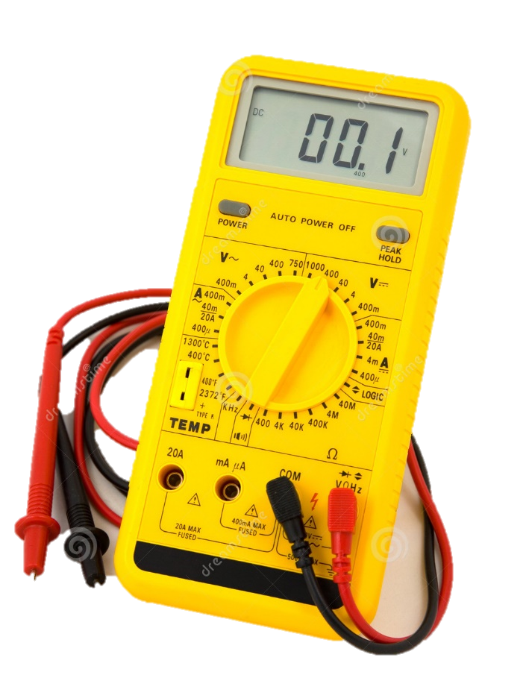
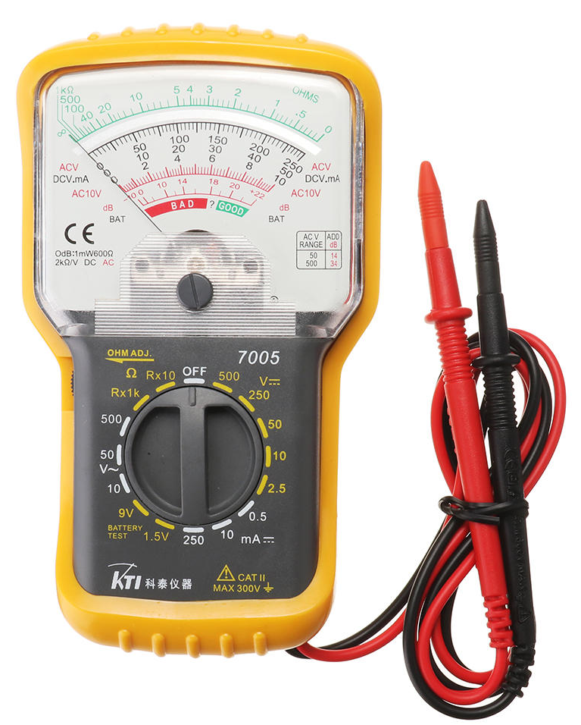
STATIC AND DYNAMIC CHARACTERISTICS

Slide 4
Static characteristics
Accuracy
Precision
Error
Sensitivity
Resolution
Threshold
Linearity
Zero drift
Reproducibility
Stability

Slide 5
Static characteristics…
1. Accuracy:
Degree of closeness which the instrument reading approaches the true value of the quantity to be measured.
It indicates the ability of an instrument to indicate true value of the quantity.

Slide 6
Static characteristics…
2. Precision:
It is the measure of a consistency or repeatability of a measurement.
It denotes the closeness with which the individual measurements are departed or distributed about the average of numbers of measured values.
High precision may not have high accuracy.
Types of Precision
Conformity
Number of significant figures

Slide 7
Static characteristics
Conformity
Error created due to limitation of scale reading is a precision error. e.g. resistor value is 2385702 Ω is read as 2.4MΩ
Significant figures
Precision is obtained from number of significant figures. e.g. 110Ω can be specified as 109Ω or 111Ω thus 3 significant figures. If it is specified as 110.0Ω then it may be 110.1Ω or 109.9Ω thus four significant figures.
Greater the significant figures greater is the precision

Slide 8
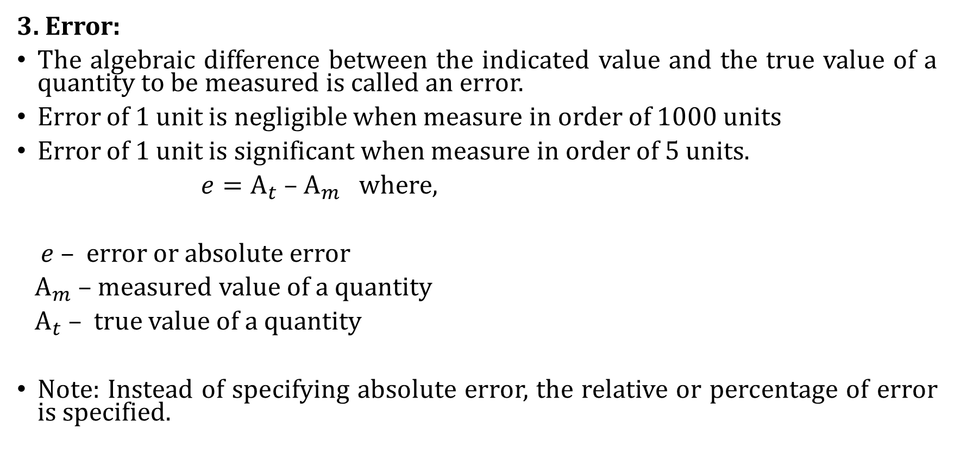
Static characteristics
3. Error:
The algebraic difference between the indicated value and the true value of a quantity to be measured is called an error.
Error of 1 unit is negligible when measure in order of 1000 units
Error of 1 unit is significant when measure in order of 5 units.
$e={\text{A}}_{t}\text{ – }{\text{A}}_{m}$ where,
$e$ – error or absolute error
${ \text{A}}_{m}$ – measured value of a quantity
${\text{A}}_{t}$ – true value of a quantity
Note: Instead of specifying absolute error, the relative or percentage of error is specified.

Slide 9
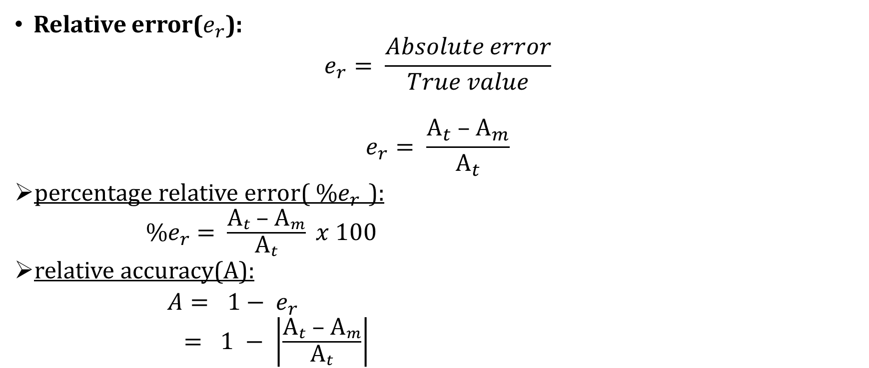
Static characteristics
Relative error($e_{r}$):
$$e_{r}= \frac{Absolute error}{True value}$$
$$e_{r}= \frac{{\text{A}}_{t}\text{ – }{\text{A}}_{m}}{{\text{A}}_{t}}$$
percentage relative error(${ \%e}_{r }$):
${ \%e}_{r} = \frac{{\text{A}}_{t}\text{ – }{\text{A}}_{m}}{{\text{A}}_{t}} x 100$
relative accuracy(A):
$A= 1− e_{r}$
$= 1 − \left|\frac{{\text{A}}_{t}\text{ – }{\text{A}}_{m}}{{\text{A}}_{t}}\right|$

Slide 10

Static characteristics
percentage accuracy($a$):
$a= A x 100\%$
error as a % of full scale reading
$$= \frac{{\text{A}}_{t}\text{ – }{\text{A}}_{m}}{f.s.d} x 100$$
Where;
f.s.d – full scale deflection

Slide 11
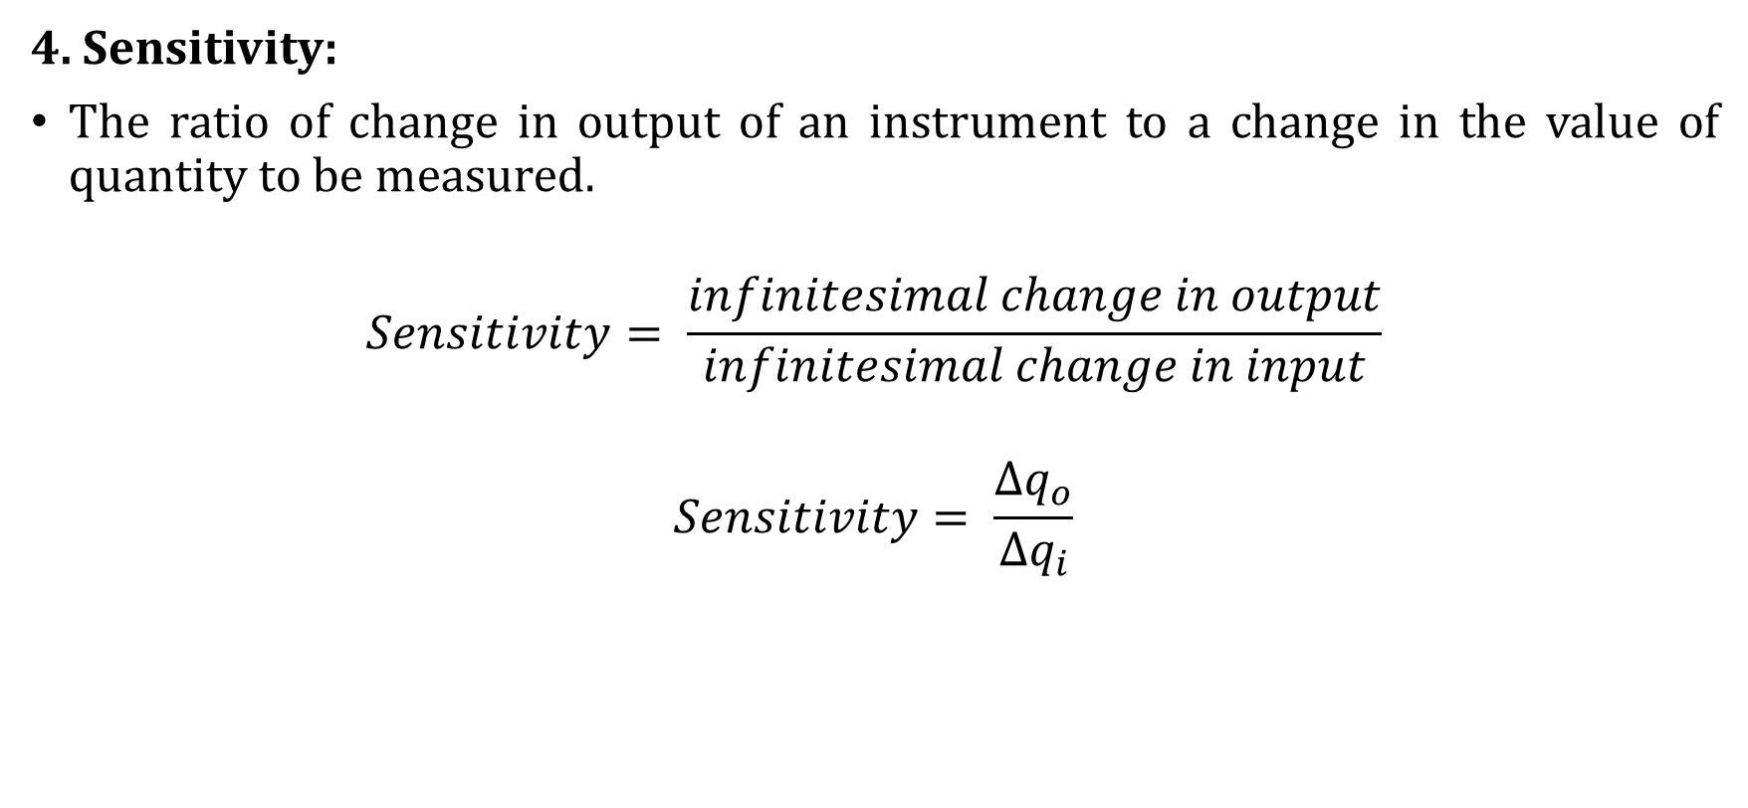
Static characteristics
4. Sensitivity:
The ratio of change in output of an instrument to a change in the value of quantity to be measured.
$$Sensitivity= \frac{infinitesimal change in output}{infinitesimal change in input}$$
$$Sensitivity= \frac{{∆q}_{o}}{∆q_{i}}$$

Slide 12
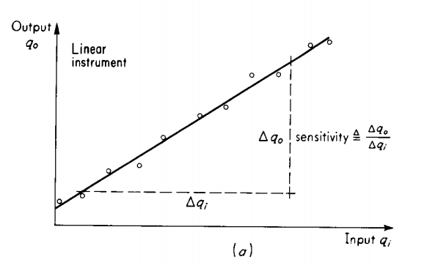
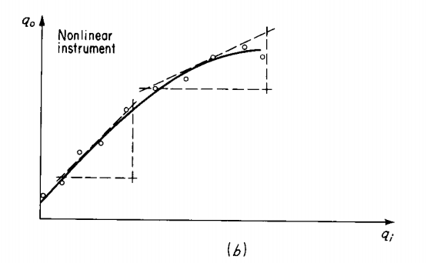
Static characteristics

Slide 13
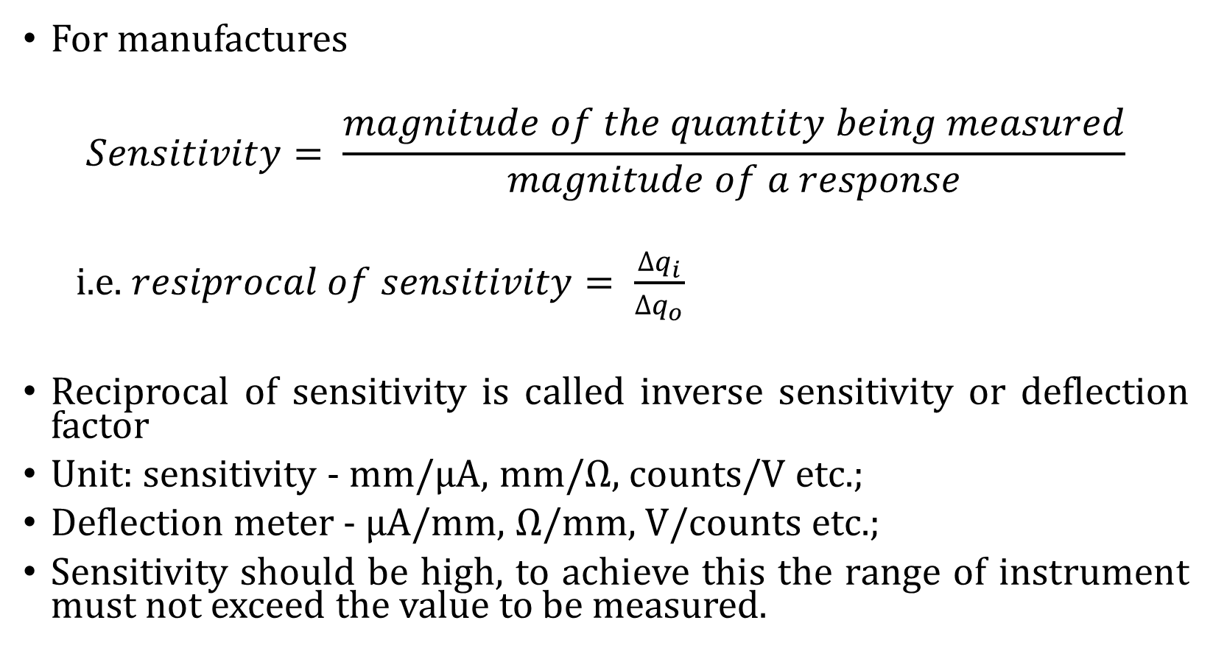
Static characteristics
For manufactures
$$Sensitivity= \frac{magnitude of the quantity being measured}{magnitude of a response}$$
i.e. $resiprocal of sensitivity= \frac{∆q_{i}}{{∆q}_{o}}$
Reciprocal of sensitivity is called inverse sensitivity or deflection factor
Unit: sensitivity - mm/μA, mm/Ω, counts/V etc.;
Deflection meter - μA/mm, Ω/mm, V/counts etc.;
Sensitivity should be high, to achieve this the range of instrument must not exceed the value to be measured.

Slide 14
Static characteristics…
5. Resolution:
The smallest increment in the value of measurand that results in a detectable increment in the output.
It is expressed in the percentage of measurand range.
Resolution means smallest measurable input change.
6. Threshold
If the input is slowly varied from zero, the output does not change until some minimum value of the input is exceeded.
This minimum value of input is called threshold.
Threshold is the smallest measurable input.

Slide 15
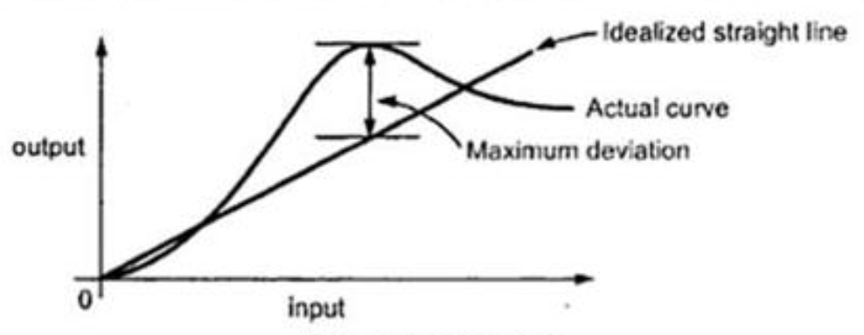
Static characteristics
7. Linearity:
The closeness to which a curve approximate a straight line
It is defined as a maximum deviation of the actual calibration curve(o/put) from the idealized straight line , expressed as a % of a full scale reading or % of actual reading.

Slide 16
Static characteristics
8. Zero drift/Bias
The deviation of the instrument output with time from its zero value, when the variable to be measured is a constant. This can also be called the constant error which exist over the full range of measurement of an instrument.
9. Reproducibility
It is the degree of closeness with which a given value may be repeatedly measured.
Reproducibility and repeatability are a measure of the closeness with which a given input may be measured again and again.

Slide 17
Static characteristics
10. Stability:
Ability of an instrument to retain its performance throughout its specified operating life and the storage life.
Tolerance:
The maximum allowable error in the measurement is specified in terms of some value which is called tolerance

Slide 18
Dynamic characteristics
Speed of response
Fidelity
Lag
Dynamic error

Slide 19
Dynamic characteristics
1. Speed of response
It gives information about how fast the system reacts to the changes in the input.
2. Fidelity
It is defined as the degree to which an instrument indicates the changes in the measured variable without dynamic error.
3. Lag
Delay in the response of a system.
Retardation lag: response of the system begins immediately after a change in a variable has occurred.
Time delay: response begins after sometime called dead time, after application of input.

Slide 20
Dynamic characteristics
4. Dynamic error
The difference between the true value of a variable to be measured changing with time and a value indicate by the measurement system assuming zero static error.

Slide 21
QUESTIONS
???

Slide 22
Discussion
Significance of measurement with examples
Evolution of instruments
Electronic measurement
Elements of a measuring instrument
Static characteristics
Dynamic characteristics

